Slide 1
Spring Lecture 6
Spring’s Bean Scope

Slide 2
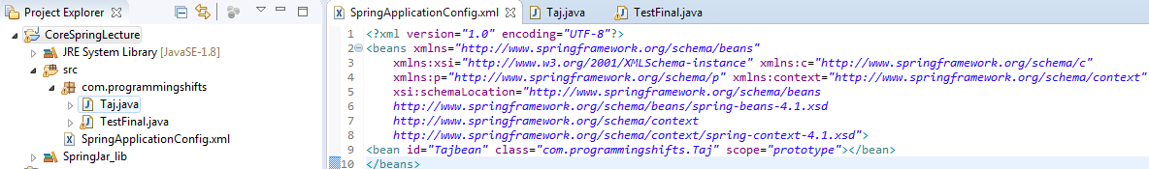
Spring’s Bean Scope
You provide scope of a bean in the spring’s configuration file using scope attribute with each bean definition.

Slide 3
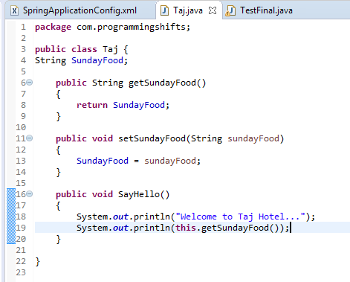
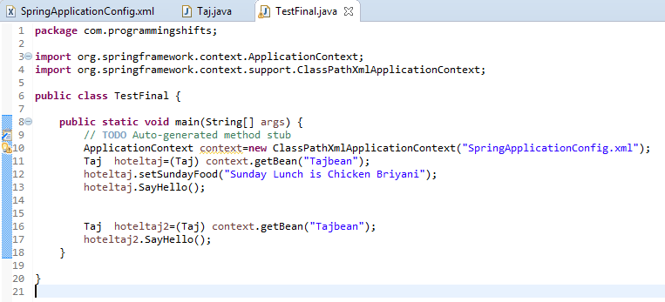

Slide 4
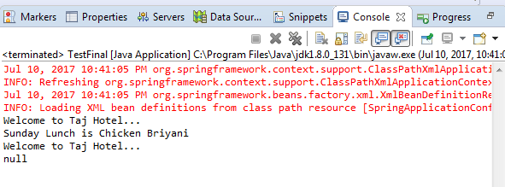
OUTPUT
For each object
We need to set value

Slide 5
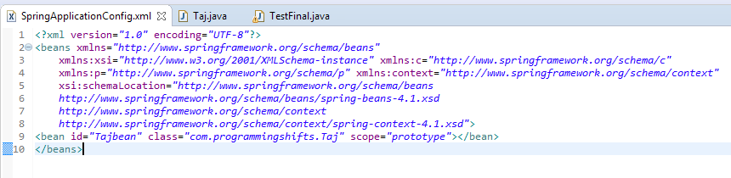
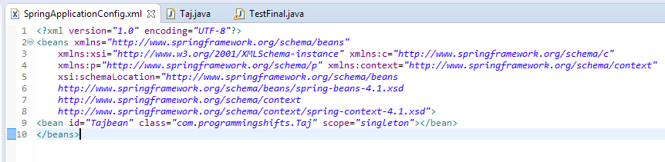
On Changing Scope

Slide 6
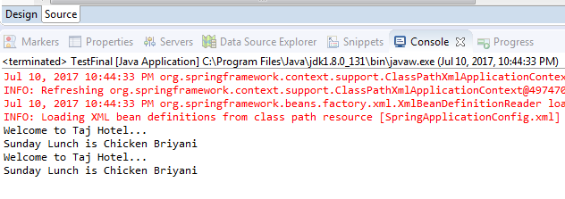
For each object Value remains same. No need to set value again and again

Slide 7
Thank U ☺

